Slide 1

Classification
Logistic Regression
& KNN

Slide 2
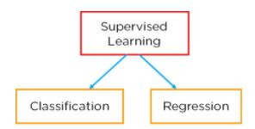

Slide 3

What is Classification?
Classification is defined as the process of recognition, understanding, and grouping of objects and ideas into preset categories .

Slide 4

One of the most common applications of classification is for filtering emails into “spam” or “non-spam”

Slide 5


Slide 6
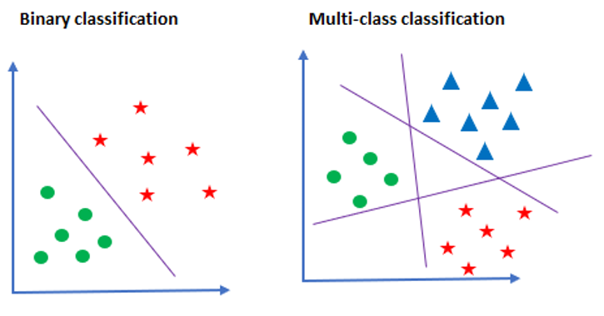

Slide 7
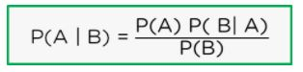
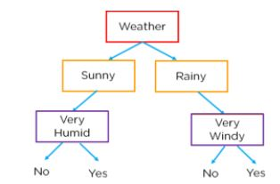
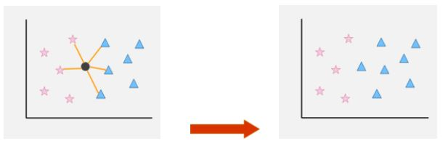
Classification Models
Naive Bayes
Decision Trees
Logistic Regression
K-Nearest Neighbors

Slide 8
What is Logistic Regression?
Logistic regression is a statistical method that is used for building machine learning models where the dependent variable is dichotomous: i.e. binary. Logistic regression is used to describe data and the relationship between one dependent variable and one or more independent variables.

Slide 9
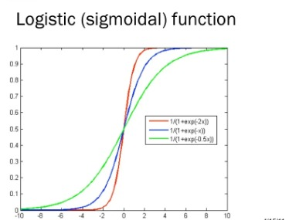
logistic regression
The name “logistic regression” is derived from the concept of the logistic function that it uses. The logistic function is also known as the sigmoid function. The value of this logistic function lies between zero and one.

Slide 10
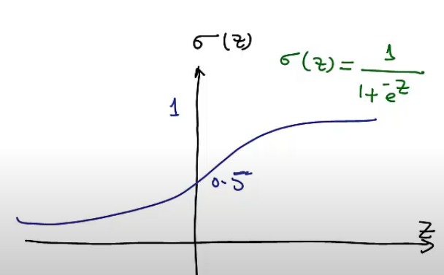
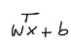
Logistic Regression

Slide 11
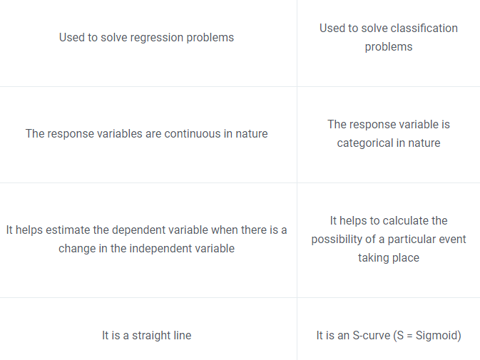
Linear Regression vs. Logistic Regression

Slide 12

Code (Linear & Multiclassification)

Slide 13
K-nearest neighbors
K-nearest neighbors (KNN) algorithm is a type of supervised ML algorithm which can be used for both classification as well as regression predictive problems.

Slide 14
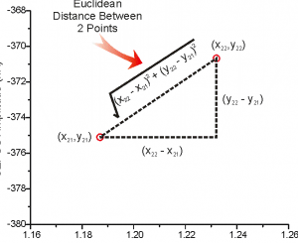
K-nearest neighbors
Calculate the distance between test data and each row of training data with the help of any of the method namely: Euclidean, Manhattan or Hamming distance.
The most commonly used method to calculate distance is Euclidean.

Slide 15
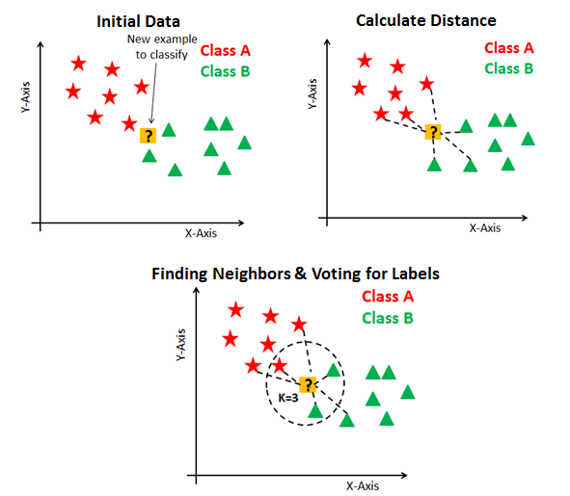

Slide 16
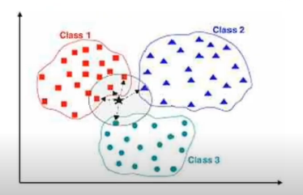

Slide 17


Slide 18


